Slide 1
Lab 5 Presentation:
CLASS APPLICATION
Cristina Chung 100711128
Vidit Vyas 100586296
Jane Coralde 100660214

Slide 2



INTRO
AN APP THAT KEEPS EVERYONE CONNECTED
Allows users like students, faculty members, and alumni of OTU to communicate and be up-to-date with events or important announcements.
Notes:
Our team decided on building a school application to keep students, alumni and faculty connected at Ontario Tech. This application will allow alumni to keep in touch with classmates, help students and staff stay updated about any events or important announcements as well as networking opportunities.

Slide 3

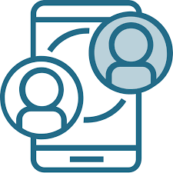
PRODUCT DESCRIPTION
An app close to a social media application exclusively for the Ontario Tech community to keep everyone connected and informed!
secure log in
event announcements
private messaging
course info, announcement, & grades
graduation tracking
access to student services
Notes:
With busy lives and a lot going on around technology can help us keep connected and informed. Blackboard and myCampus interface are not very user friendly therefore we decided to create an application close to a social media application exclusively for the Ontario Tech community. Some key features our app has but not limited to are: *click* *click* *click*

Slide 4


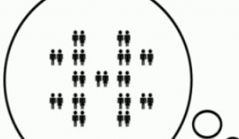
OBJECTIVES
Secure login, registration, and keep personal information safe
Seamless user interface for both new and experienced users
The initial prototype must be able to handle at least 8,000 users smoothly
Notes:
Secure login, registration and keep personal information safe.
It should have a seamless user interface for both new and experienced users.
For the initial prototype, the app is able to handle at least 8,000 users smoothly.

Slide 5

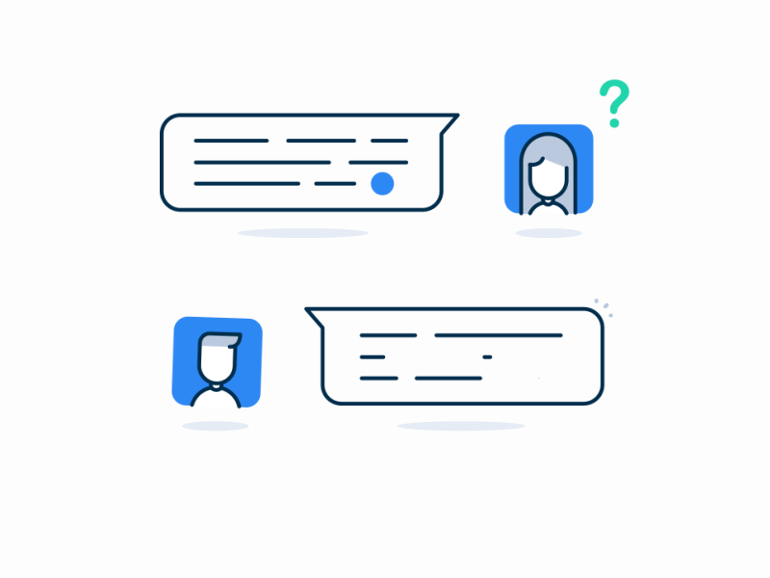

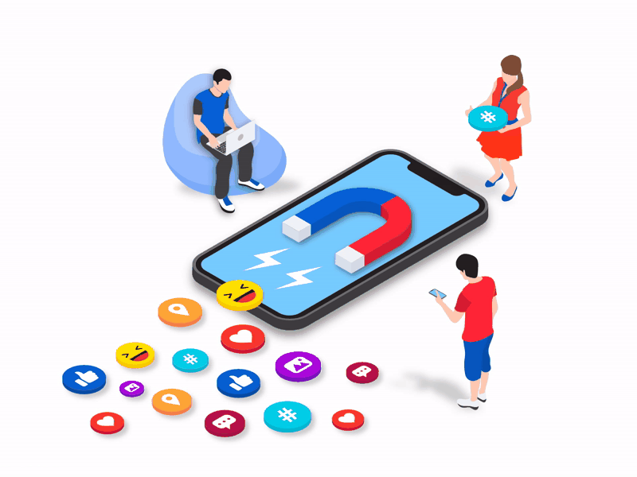
OBJECTIVES
Access accounts at all times.
Real-time secure live chat
Offers support such as FAQ’s
Support social integration. Users may link third-party apps like LinkedIn, Twitter, Instagram
Notes:
4. Users should be able to access their accounts at all times
5. Implement real-time secure live chat between users.
6. Supports social integration, users may link third-party applications like LinkedIn, Twitter, Instagram, etc.
7. Offers support such as FAQ’s.

Slide 6


MEASURES OF SUCCESS
Beta version be tested by October.
Costs cannot exceed project’s budget.
Must have at least 5000 users six months after launch.
At least 50% of users must actively use the app.
Positive feedback from users.
Maintenance through updates and bug fixes.
Notes:
Beta version must be tested by *date*
Project costs cannot exceed *project budget*
6 months into the launch of the app, at least 5000 accounts must have been created
At least 50% of the accounts created should remain as active users or continually use the app.
Positive feedback from users
Maintenance of the app through updates and bug fixes.

Slide 7
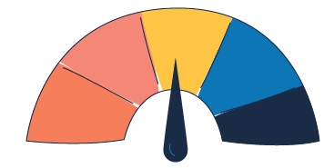
RISKS
An uncertain event or condition that, if it occurs, has a positive or negative effect on a project’s objectives

Slide 8

SOFTWARE DEVELOPMENT DELAYS
Staff are not really familiar with developing full working applications, therefore there will be several challenges that the team will have to face. Arising software development complications may cause overall project delays. The team will try their best to divide and conquer the problem by helping each other. Staff will also check on each other’s work periodically to make sure the project is going according to plan.

Slide 9

USER’S
SECURITY
This project consists of a social application, this means users will be exposed to cyberbullying, scams, blackmail and other types of harms. As creators of the application we need to make sure to have strict policies and allow users to report any kind of inappropriate content. After the application is up and running the team will be in charge of checking and dealing with these types of issues to make sure users feel safe when using our application.

Slide 10
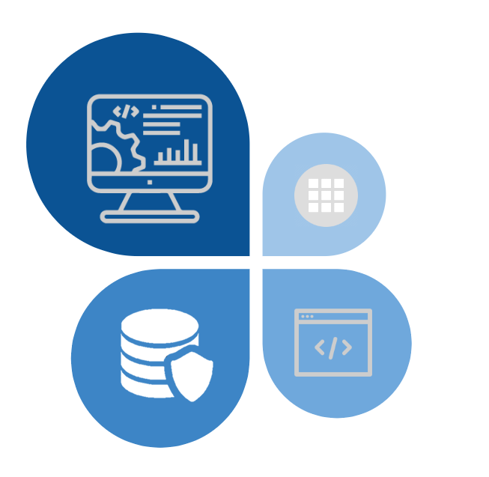
INFRA-
STRUCTURE

Slide 11
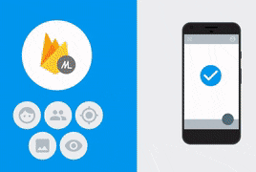
BACKEND:GOOGLE FIREBASE
Google Firebase has amazing built-in features like authentication, file storage, etc. that will improve the quality of the application.
Notes:
Will manage backend services for our application.
We will use it’s real-time database server which is a cloud hosted database (Cloud Firestore) to store and manage all our data.

Slide 12
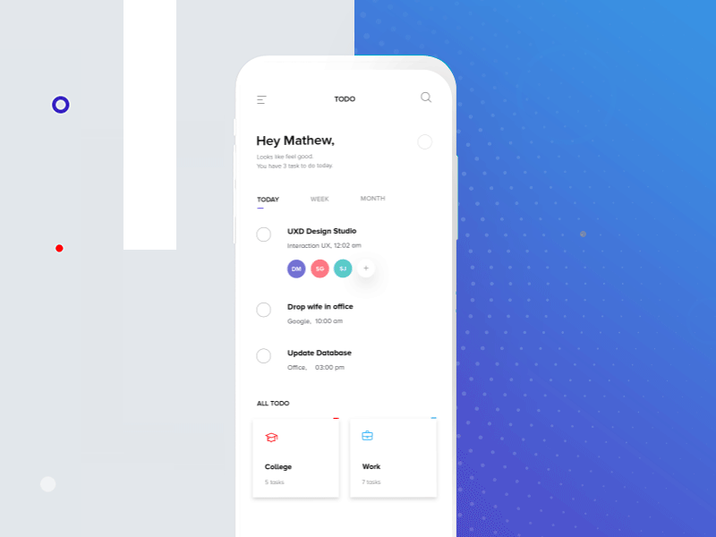
FRONTEND:FLUTTER SOFTWARE
Flutter uses a specific programming language called Dart. Allows us to access their APIs and other amazing services.
Notes:
Will manage front-end services for our application.
We decided to use Flutter to write our code because it is a single codebase tool which means that the application can run on any Android or iOS device from one codebase.

Slide 13

HARDWARE DEVICES &
MOBILE SIMULATOR
A laptop, smartphone, or a tablet can be used to access the app.
Android Studio is used to perform simulations on these different platforms.
Place your screenshot here
Place your screenshot here
Notes:
We will be using Android Studio IDE for software development. In that, they have a built-in mobile simulator for both Android and iOS devices. Therefore, we will be using those simulators to design and test our application

Slide 14
25 KLOC
96 person-month
8 months
Organic project system
Effort
Duration

Slide 15
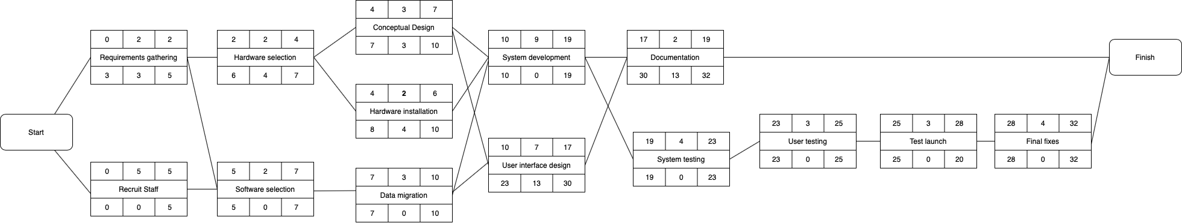
ACTIVITY DIAGRAM

Slide 16
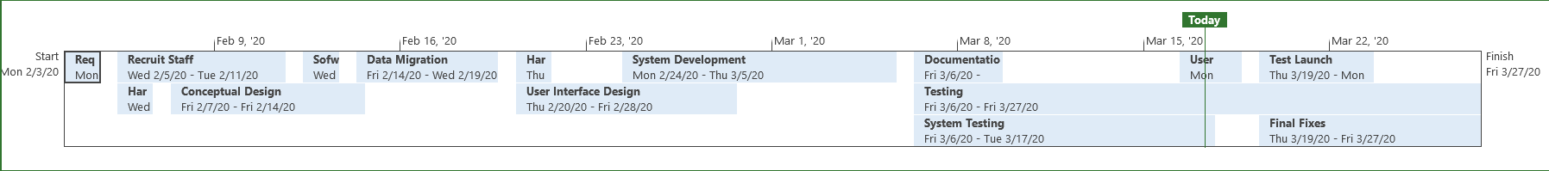
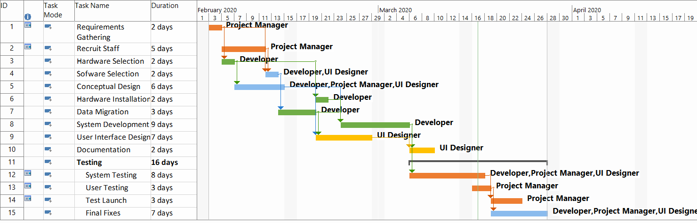
GANTT CHART

Slide 17
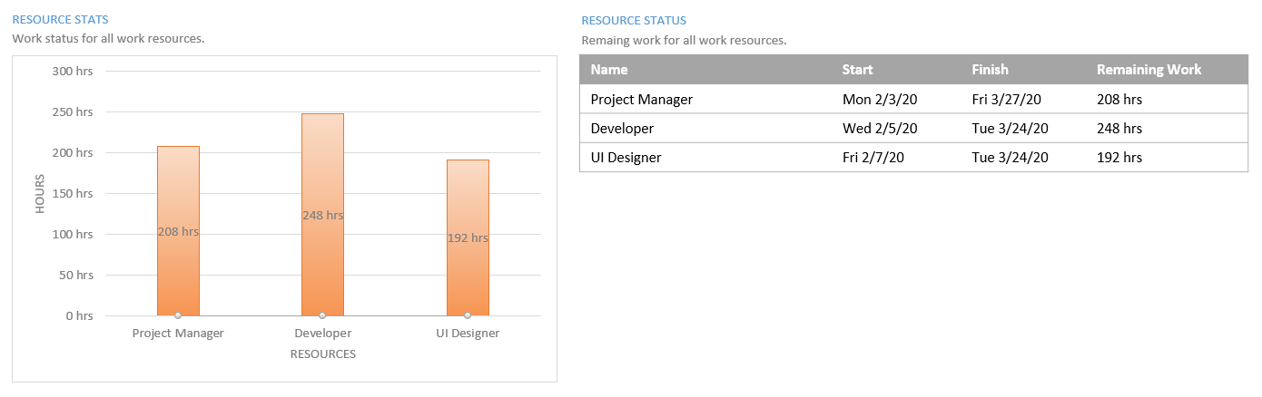



RESOURCE OVERVIEW
Notes:
Product Manager
The product manager is arguably the most important role in the entire team. He or she is responsible for:
Driving the vision of the product
Liaising with customers
Coming up with the project scope that the entire team must follow to create a product that will serve customers’ needs.
Developer:
Developers are the ones who actually write and launch the code of the software or application.
Depending on what your particular project requires, it is typically better to hire specialized resources for that particular technology.
UI Designer
Communicate with the product manager and developers to create stunning visuals for the product.
Create the visual assets from the initial concept to launch.
Create wireframes, storyboards, user flows, process flows, and sitemaps to effectively communicate interaction and design ideas.

Slide 18

THANKS!
Any questions?

